Slide 1
Adaptation Policy
Science and scenarios
Abatement costs
Instruments for emission reduction
Impacts of climate change; valuation
Economic impacts; marginals; distribution
Impacts and development
Adaptation policy
Optimal climate policy
Discounting, equity, uncertainty

Slide 2
Adaptation
If climate changes, people and companies would change their behaviour to alleviate the negative consequences and make the most of the positive consequences
Because of adaptation, the impacts of climate change are not as bad, and there is less need to mitigate
Adaptation and mitigation are substitutes
Therefore, policy makers have long ignored adaptation, as it would admit defeat
Policy makers now realise that mitigation cannot be perfect, and that adaptation is necessary

Slide 3
Adaptation -2
Policy makers now realise that mitigation cannot be perfect, and that adaptation is necessary
Climate change cannot be fully avoided. In fact, we’re committed to 2-3 degrees of further warming
Successful mitigation depends on other countries, successful adaptation does not

Slide 4
How to adapt?
Uncertainty is a major challenge in adaptation, but it really only matters with long-lived, water-related infrastructure

Slide 7
How to adapt?
Uncertainty is the main challenge in adaptation, and it really only matters with long-lived, water-related infrastructure
If you know that the future will be different, but you don‘t know how, you should be
More robust
More flexible
Elsewhere, systems turn over much faster than climate will change

Slide 8
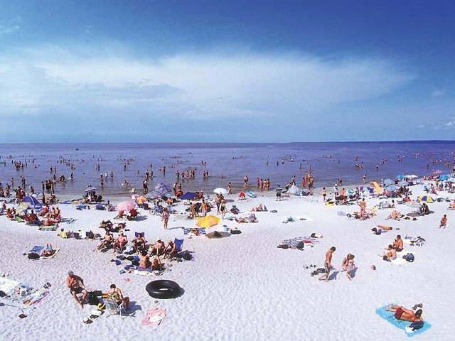
The Gruenspecht Rule of Adaptation

Slide 9
Adaptation -3
Policy makers now realise that mitigation cannot be perfect, and that adaptation is necessary
This had led national governments to formulate national adaptation plans – indeed, this is an obligation under international law
Multilateral organizations are also formulating international adaptation plans
Rich countries will finance adaptation in poor countries
Bonanza for consultants!

Slide 10
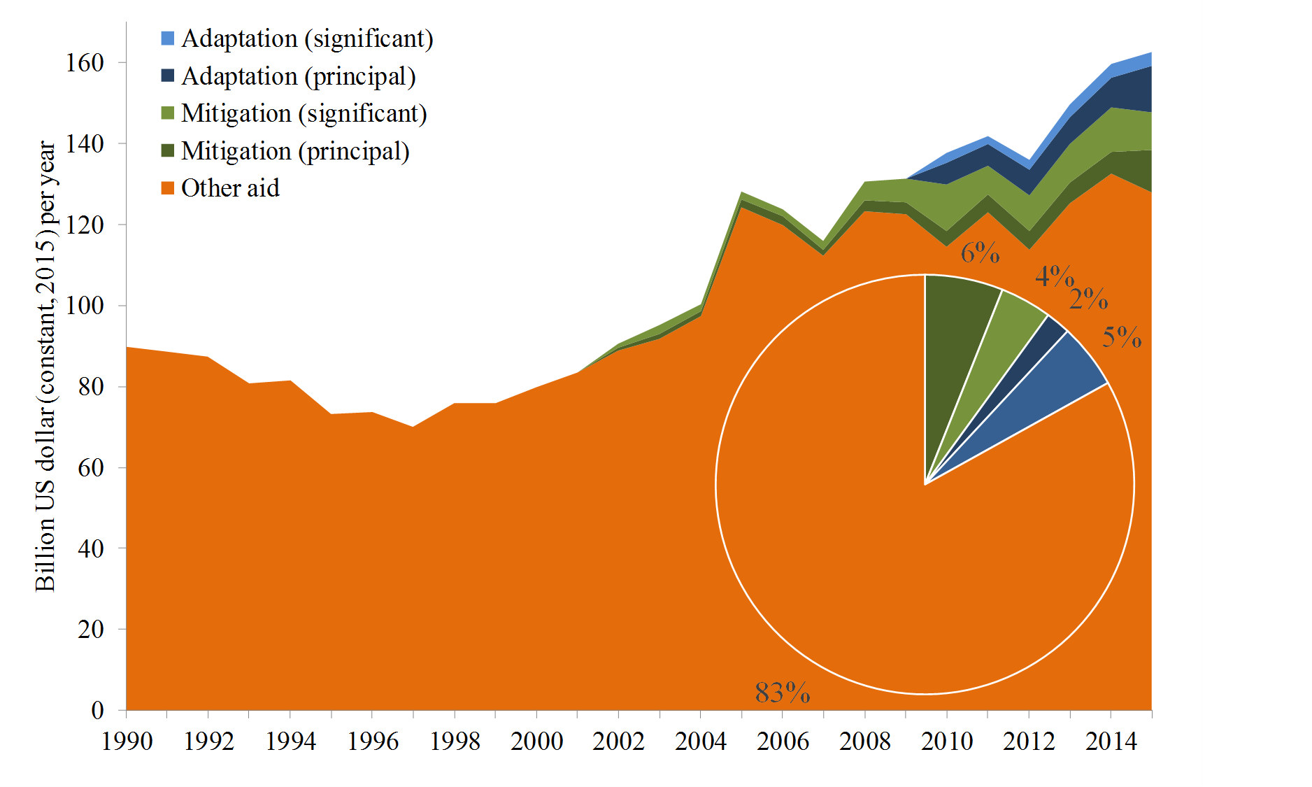

Slide 11
Adaptation -3
Policy makers now realise that mitigation cannot be perfect, and that adaptation is necessary
This had led national governments to formulate national adaptation plans – indeed, this is an obligation under international law
Multilateral organizations are also formulating international adaptation plans
Rich countries will finance adaptation in poor countries
Adaptation is development

Slide 12
Adaptive Capacity
Adaptive capacity is the ability to adapt
Adaptive capacity depends on
Available technological options
Available resources & their distribution
Human capital
Social capital
Risk sharing
Information management and attribution
Decision making
However, adaptation is driven by environmentalists, who have a 1950s understanding of development

Slide 14
Adaptation -3
Policy makers now realise that mitigation cannot be perfect, and that adaptation is necessary
This had led national governments to formulate national adaptation plans – indeed, this is an obligation under international law
Multilateral organizations are also formulating international adaptation plans
Rich countries will finance adaptation in poor countries
Why? Most adaptation is private!

Slide 15
Who should adapt?
Public intervention is justified
to correct externalities
to provide public goods
to prevent congestion or overexploitation
to remedy market power
to correct asymmetric information

Slide 16
Public v private adaptation
There is a role for the government, though
During a heat wave, you should
Wear little clothes
Stay calm
Keep out of sun
Drink lots (but no alcohol)
Some adaptation is collective: Siestas and late dinner make physiological sense in hot places
At best, the government should run a heat awareness and preparedness campaign
During the 2003 heat wave in France, many people died because of public failures

Slide 17
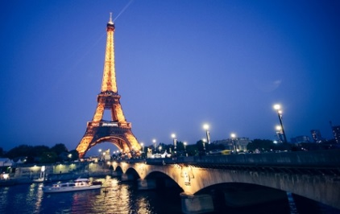
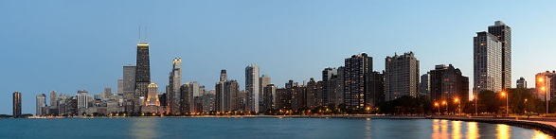
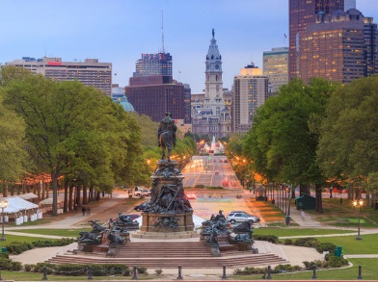
Public v private adaptation -2
During the 2003 heat wave in France, many people died because of public failures
Medical professionals were on holiday, and there was no procedure for calling them back
Shopping malls are air-conditioned; security personnel removed people seeking relief from the heat
In crime-ridden areas, people were afraid to open their windows
Poor people could not afford to turn on their fans
Public intervention complements private adaptation

Slide 18
Public adaptation
Coastal protection is a public good
Irrigation is often treated as a public good
Agricultural extension is often treated as a public good

Slide 19
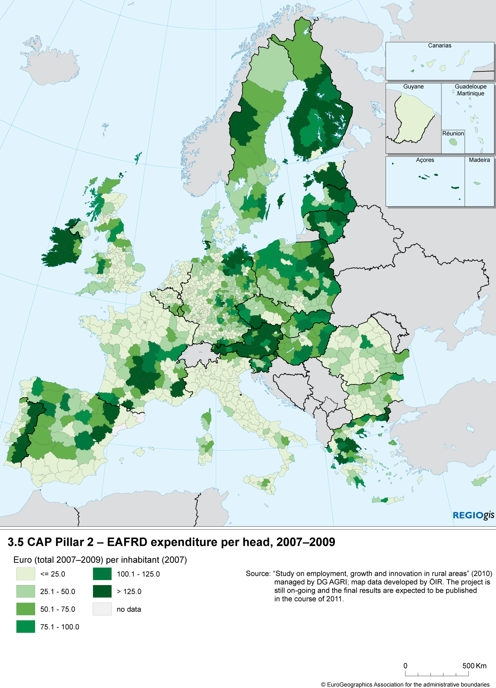
Public maladaptation
The subsidies for agriculture in Europe have two purposes
Reduce regional differences
Shield farmers from market volatility
Trade policy shield farmers from foreign competition
This locks farmers into their current crop choices and management practices

